Slide 1
Lecture 3.1 – 3.2
Shortest path

Slide 2
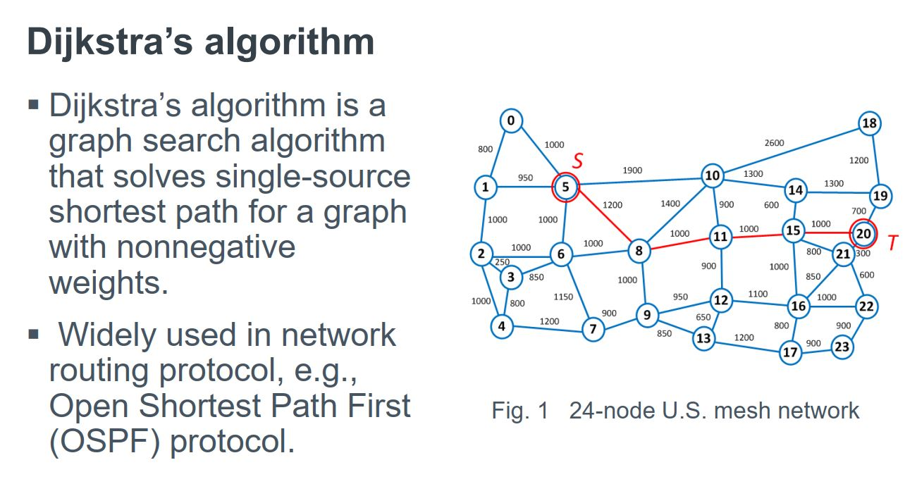
Application

Slide 3
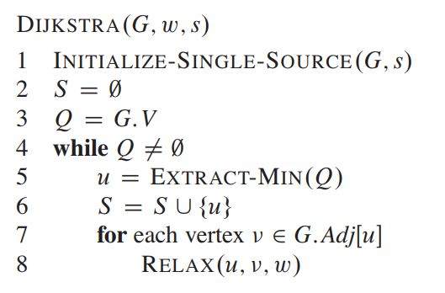
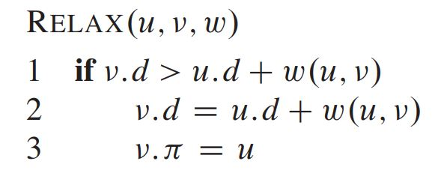
Algorithm

Slide 4
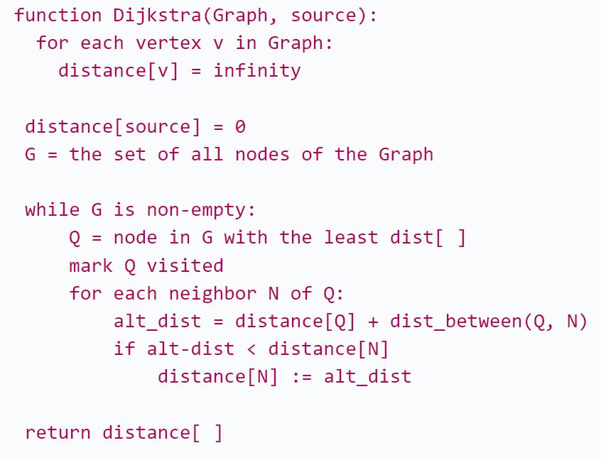
Algorithm

Slide 5
Complexity of Priority Queue
Priority Queue Data Structure | Push Node | Pop Node | Decrease Key
Array | O(N) | O(N) | O(N)
Binary Heap | O(log(N)) | O(log(N)) | O(log(N))
Binomial Heap | O(1) | O(log(N)) | O(log(N))
Fibonacci Heap | O(1) | O(log(N)) | O(1)
Notes:
Source: https://medium.com/@vikramsetty169/time-complexity-of-dijkstras-algorithm-ed4a068e1633

Slide 6
Complexity?
With decrease-key operation:
V push operation
V remove operation
E decrease-key operation
Without decrease-key operation:
E insert operation
E remove operation

Slide 7
Complexity?
With decrease-key:
Array: O(V^2 + EV)
Binary heap: O(VlogV + ElogV) = O((E+V)logV)
Fibonacci heap: O(VlogV + E)
Without decrease-key:
Binary heap: O(ElogV + ElogV) = O(ElogV)

Slide 8
Goal of the Proof
Assume, S: set of nodes whose shortest distances are finalized. We need to show that when a node v is added to S:
d[v] = δ(s, v)
d[v]: Shortest distance to node v, calculated by the algorithm
δ(s, v) is the true shortest distance from s to v
Trivially we can say, the calculated distance can’t be better than actual shortest distance: d[v] ≥ δ(s, v)….. (eq: 1)

Slide 9
Proof Outline (by Induction)
Base case: d[s] = δ(s, s) = 0 (trivial)
Inductive step:
Assume d[u] = δ(s, u) for all u in S
Show that for the next node v selected: d[v] = δ(s, v)

Slide 10

Proof Continue…
Let 𝑃 be a shortest path from 𝑠 to 𝑣, and let 𝑢 be the last node on 𝑃 such that 𝑢∈𝑆 and the next node 𝑤∉𝑆.
Since 𝑢∈𝑆, by the inductive hypothesis:
𝑑[𝑢]=𝛿(𝑠,𝑢)

Slide 11
Proof Continue…
After relaxing (u, w), where u ∈ S and (u, w) is on shortest path:
d[w] ≤ d[u] + w(u, w)
Since d[u] = δ(s, u), we get:
d[w] ≤ δ(s, u) + w(u, w)
Since edge (u,w) is in the shortest path:
δ(s,w) = δ(s,u)+w(u,w)
So:
d[w] ≤ δ(s,w) ….. (eq: 2)

Slide 12
Proof Continue…
As the algorithm picks v, before w, so:
d[v] ≤ d[w] …. (eq: 3)
Combining equation 2, and equation 3:
d[v] ≤ δ(s,w) …. (eq: 4)
Now: δ(s,v) = δ(s,w)+cost(w 🡪 v), and every edge is non-negative. So the cost will be greater or equal to 0. So:
δ(s,v) ≥ δ(s,w)
From equation 4:
d[v] ≤ δ(s,v) …. (eq: 5)

Slide 13
Proof Continue…
We have proved both of these equations:
d[v] ≥ δ(s, v)….. (eq: 1)
d[v] ≤ δ(s,v) ….. (eq: 5)
Both equation can only be true, if:
d[v] = δ(s,v)

Slide 14
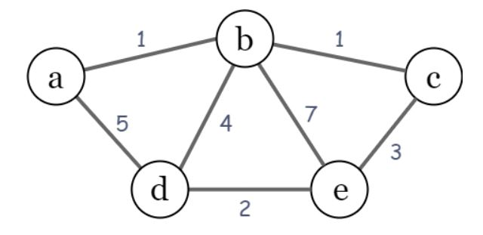
Example

Slide 15
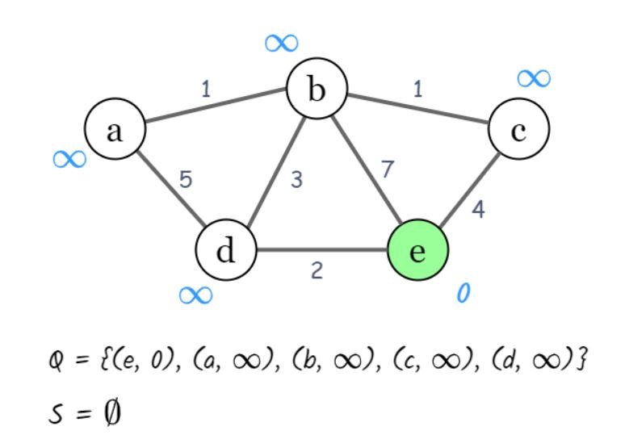
Example

Slide 16
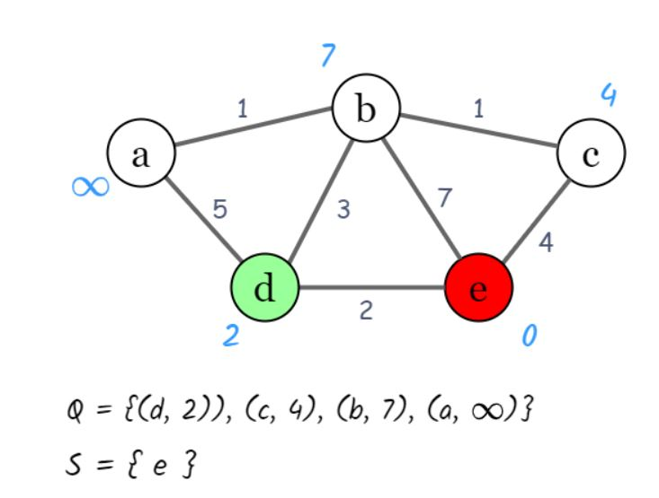
Example

Slide 17
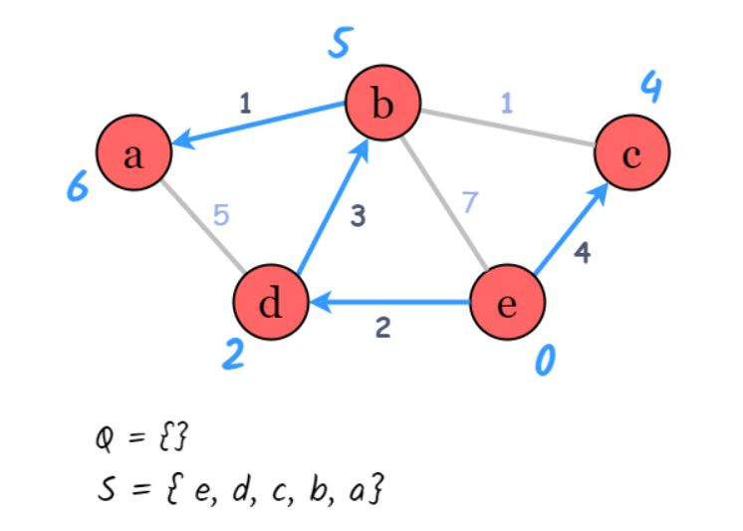
Example

Slide 18
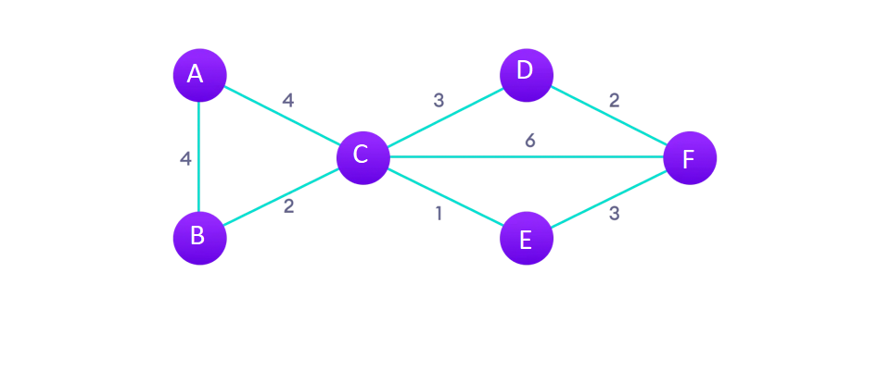
Example

Slide 19
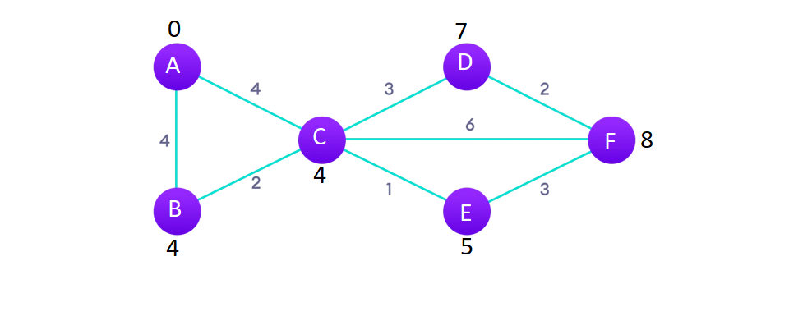
Example

Slide 20
Implementation
typedef pair<long long, long long> pr;
vector<pr> adj[MAX]; // For adjacency list
void addEdge(int u, int v, int w){ adj[u].push_back(make_pair(w,v)); adj[v].push_back(make_pair(w,u));
}

Slide 21
Implementation
priority_queue< pr > Q; // default sorting is descending
priority_queue<pr, vector<pr>, greater<pr> > Q;

Slide 22
Implementation
for(int i = 1; i <= n; i++){
dist[i] = infinity;
}
dist[src] = 0;
Q.push(make_pair(dist[src], src));

Slide 23
Few practice problems
CSES 1671
https://cses.fi/problemset/task/1671
Codeforces 449B
https://codeforces.com/problemset/problem/449/B
Codeforces 20C
https://codeforces.com/problemset/problem/20/C/
UVA 10986
https://onlinejudge.org/index.php?option=onlinejudge&Itemid=8&page=show_problem&problem=1927

